Slide 1


PRESENTATION : FINAL REVIEW
BATCH No.: J5
DOMAIN:Machine Learning
PROJECT TITLE:CREDIT CARD FRAUD DETECTION
TYPE AND REVALANCE OF THE PROJECT: Supervised learned program designed
find the difference between real and fake transctions in credit cards
S. No. | Register number | Name of the Student
1 | U18CN241 | L. Ajay ram
2 | U18CN244 | B. Bhumesh
3 | U18CN245 | S. Santhosh
4 | U18CN228 | P. V. M. Ramesh Chandra
GUIDED BY: Dr.M.K.VidhyaLakshmi

Slide 2
PRESENTATION : FINAL REVIEW
AGENDA : Detection of the fake credit card transcations
Objective:Credit Card Fraud Detection Using Machine Learning
Methodology:Using Random Forest Machine learning algorthim to find the fraud or fake transcations
Applications:Trying to decreasing fake Credit cards transcations

Slide 3
Existing System:
In existing system methods such as Cluster Analysis, Bayesian network, Logistic Regression, Naïve Bayer’s , Hidden Markov model etc are used to find out the credit card fraud transactions.
The methods used in the existing system are based on unsupervised learning and the accuracy obtained by these methods is about 60-70%.
DEPARTMENT OF COMPUTER SCIENCE AND ENGINEERING
3

Slide 4
Proposed System:
Supervised learning using Random forest machine learning algorthim
The proposed system overcomes the above mentioned issue in an efficient way. It aims at analysing the number of fraud of fraud transactions that are present in the dataset.In proposed System, we use Random forest algorithm to classify the credit card dataset.
DEPARTMENT OF COMPUTER SCIENCE AND ENGINEERING
4

Slide 5
Literature survey:
S.NO | TITLE | AUTHOR | CONTENT
1 | Comprehensive Analysis for Fraud Detection of Credit Card through Machine Learning | Parth Roy; Prateek Rao; Jay Gajre; Kanchan Katake; Arvind Jagtap;(09 April 2021 ESCI) | Explains about different Machine learning algorthims in detecting credit card transations Only theory is presented but not the actual idea to implement those Machine learning algorthim
2 | Credit Card Fraud Detection Using Various Classification and Sampling Techniques | J. V. V. Sriram Sasank; G. Ram Sahith; K. Abhinav; Meena Belwal (20 February 2020 International Conference on Communication and Electronics Systems (ICCES)) | Explains about different Machine learning algorthims in detecting credit card transations Implementation of theory to pratical method can be observe but didn’t provided enough output and didn’t have much exposer to the real datasets
DEPARTMENT OF COMPUTER SCIENCE AND ENGINEERING
5

Slide 6
S.NO | TITLE | AUTHOR | CONTENT
3 | Credit Card Fraud Detection : A classification analysis | Sonali Baksh(i2018 2nd International Conference on I-SMAC (IoT in Social, Mobile, Analytics and Cloud) | Propsed about the unreal and fake credit cards that are present in the cyber world In this paper it is explained that the fake cards and fake money transcations can easy done without much detection until it is too late In this paper it has providd few examples and different analysis by using unspervised learing tecqnies to find the real ones form the fake ones
4 | A Credit Card Fraud Detection Techniques | Kshitij Pandey; Piyush Sachan; Shakti; Nikam Gitanjali Ganpatrao( 2021 5th International Conference on Computing Methodologies and Communication (ICCMC)) | Explains about different Machine learning algorthims in detecting credit card transations Only theory is presented but not the actual idea to implemention those Machine learning algorthim and not and actual pratical approach
DEPARTMENT OF COMPUTER SCIENCE AND ENGINEERING
6

Slide 7
S.NO | TITLE | AUTHOR | CONTENT
5 | Credit card fraud detection with a neural-network | Ghosh; Reilly( 1994 Proceedings of the Twenty-Seventh Hawaii International Conference on System Sciences) | Explains about different Machine learning algorthims in detecting credit card transations In this paper they also used Artificial neural networks as like an mini AI to train the system It has been successful but the has required huge resources and perform the tasks
6 | Credit card fraud detection using artificial neural network | Asha RB; Suresh Kumar KR(1st International Conference on Advances in Information, Computing and Trends in Data Engineering (AICDE - 2020)) | Explains about different Machine learning algorthims in detecting credit card transations using with artifical neural networks with large datasets of credit card data In this the training the machine is taking place unsupervised learning and the data is used must be high accuracy
DEPARTMENT OF COMPUTER SCIENCE AND ENGINEERING
7

Slide 8
Base paper:International Research Journal of Engineering and Technology (IRJET) by Devi Meenakshi, Janani, Gayathri, Mrs. Indira
Title: Machine Learning For Credit Card Fraud Detection System
Published date: 03 | Mar 2019
DEPARTMENT OF COMPUTER SCIENCE AND ENGINEERING
8

Slide 9
MODULES
Data collection
Data pre-processing
Data exploration
Data visualization
Feature extraction
Evaluation model

Slide 10
Why this project?
In the present world and in the future everyone will do their financial transcation through online
We are already observing the increase in online transcations and digital transcations
We also know that not everything in the online world is true and online will always have security issues about everything including online transcations
So to reduce the financial hacks through credit cards we are doing this project
DEPARTMENT OF COMPUTER SCIENCE AND ENGINEERING
10

Slide 11
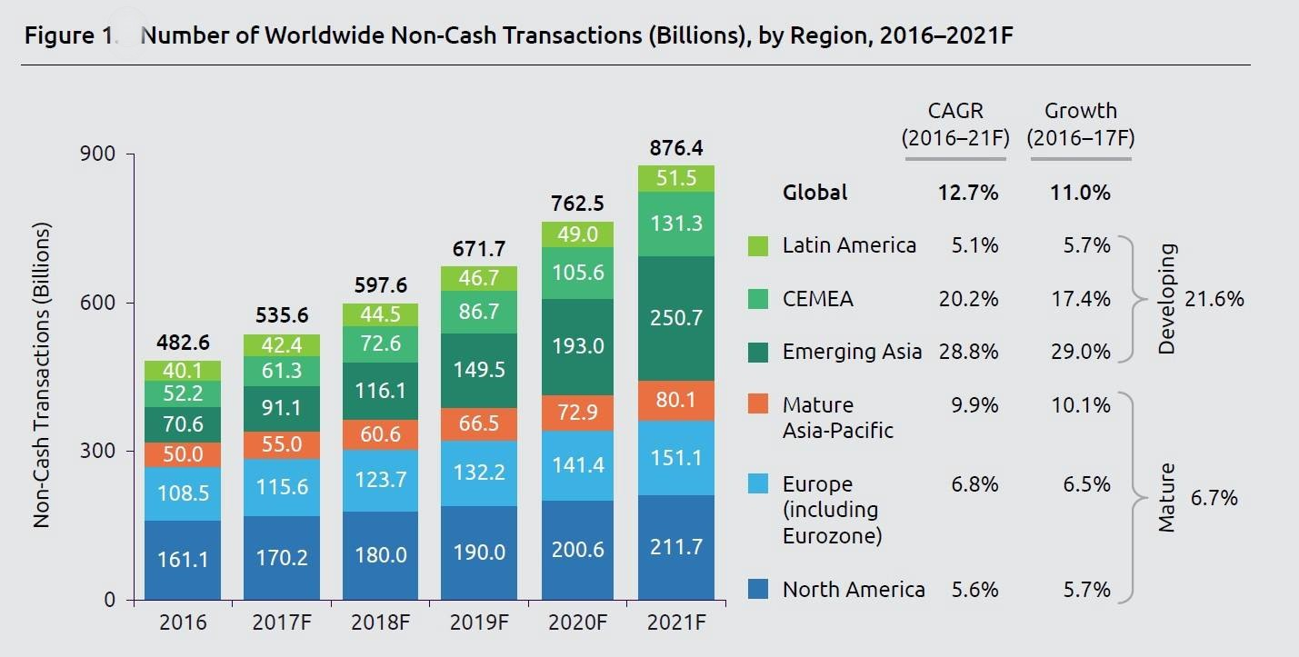
10

Slide 12
From the previous slide it can be observed that the number of online transaction had been increased by huge number and we are mostly depending on the online transactions like credit cards etc
DEPARTMENT OF COMPUTER SCIENCE AND ENGINEERING
11

Slide 13
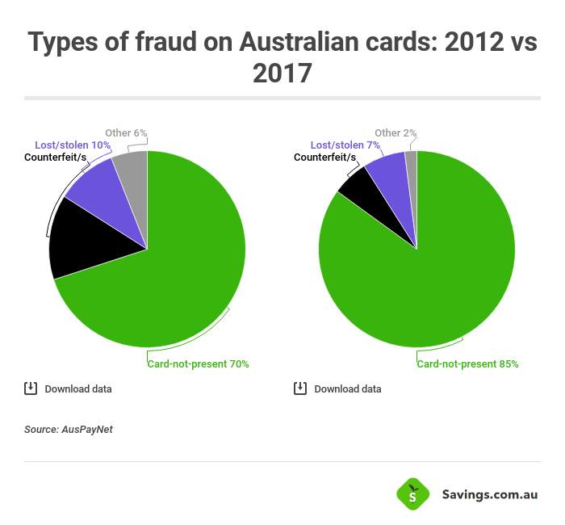
2022
DEPARTMENT OF COMPUTER SCIENCE AND ENGINEERING
12

Slide 14
FROM THE ABOVE IMAGE IT CAN OBSERVE THAT FAKE CREDIT CARDS ARE BEING USING MORE THAN THE REAL ONES
DEPARTMENT OF COMPUTER SCIENCE AND ENGINEERING
13

Slide 15


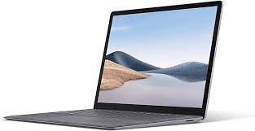
The above pictures is a general example of how credit card fraud actually done.
A hacker or an person gets your credit card details through darknet or any other way
That person will brought the prodctt through your card and the will resell the product to other person in any mode
DEPARTMENT OF COMPUTER SCIENCE AND ENGINEERING
14

Slide 16


But the money that is lost is for the retailer who sold the product and for us.
We may raise the complain and don’t pay for that but the retailer will lost all his money on the product
So to avoid this kind of frauds we are doing this project.
DEPARTMENT OF COMPUTER SCIENCE AND ENGINEERING
15

Slide 17
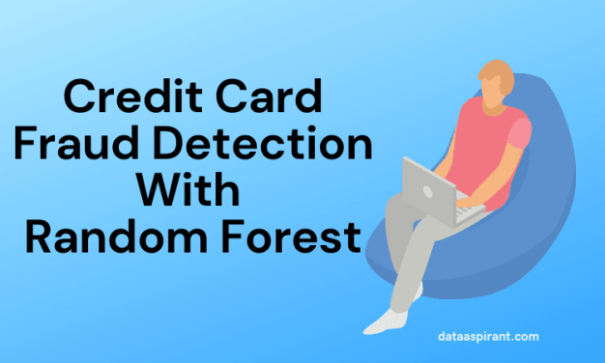
DEPARTMENT OF COMPUTER SCIENCE AND ENGINEERING
16

Slide 18
Abstract:
In our project, mainly focussed on credit card fraud detection for in real world.Intially we collect credit card datasets for trained dataset.
After classification process of random forest algorithm using the already analysing data set and user provide current dataset .Finally optimizing
The result indicate about the optimal accuracy for Random Forest are 99.98% respectively the accuracy of the result data
DEPARTMENT OF COMPUTER SCIENCE AND ENGINEERING
17

Slide 19
Software and Hardware Requriments:
Hardware:
OS - Windows 7/8/10 or 11(32 and 64 bit)
RAM - 4GB
Software:
Python
Anaconda
DEPARTMENT OF COMPUTER SCIENCE AND ENGINEERING
18

Slide 20
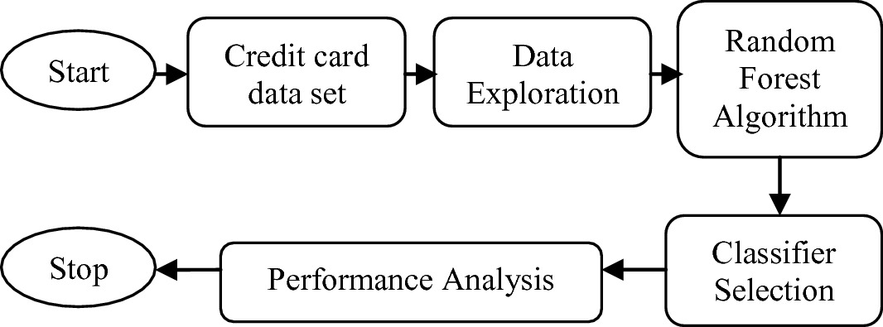
The above slide is the simple explanation of the project working and it’s process
DEPARTMENT OF COMPUTER SCIENCE AND ENGINEERING
19

Slide 21
In this part we train our program with a large complex data to determine that the transcation is legit or not
We use a huge database with huge data which is 2,84,807
In this huge data set there are only 492 fake transcations
Dataset is divided training and testing data to perform the algorthim
After that we run the data throgh the Random forest algorithm to find the accuracy and perfermance the algorthim
DEPARTMENT OF COMPUTER SCIENCE AND ENGINEERING
20

Slide 22
So by using Random forest algorithm we train our system to detect the fake ones from the real ones
In this project random forest algorthm to find the best accuracy of the algorthim and its efficency.
DEPARTMENT OF COMPUTER SCIENCE AND ENGINEERING
21

Slide 23
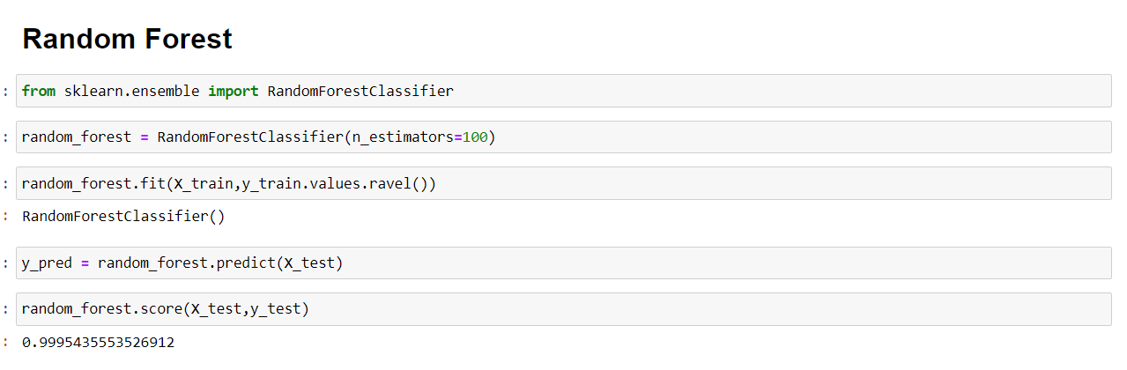
DEPARTMENT OF COMPUTER SCIENCE AND ENGINEERING
22

Slide 24
From the above table we can find the best approach for the credit card frauds and fake transcations
We can also see that Random forest method has the better approch and results when compared with the other process
DEPARTMENT OF COMPUTER SCIENCE AND ENGINEERING
23

Slide 25
References:
Andrew. Y. Ng, Michael. I. Jordan, "On discriminative vs. generative classifiers: A comparison of logistic regression and naive bayes", Advances in neural information processing systems, vol. 2, pp. 841-848, 2002
Y. Sahin, E. Duman, "Detecting credit card fraud by ANN and logistic regression", Innovations in Intelligent Systems and Applications (INISTA) 2011 International Symposium, pp. 315-319, 2011.
S. Bhattacharyya, S. Jha, K. Tharakunnel, J. C. Westland, "Data mining for credit card fraud: A comparative study", Decision Support Systems, vol. 50, no. 3, pp. 602-613, 2011.
S. Maes, K. Tuyls, B. Vanschoenwinkel, B. Manderick, "Credit card fraud detection using Bayesian and neural networks", Proceedings of the 1st international naiso congress on neuro fuzzy technologies, pp. 261-270, 2002.
B.Meena, I.S.L.Sarwani, S.V.S.S.Lakshmi,” Web Service mining and its techniques in Web Mining” IJAEGT,Volume 2,Issue 1 , Page No.385-389.
F. N. Ogwueleka, "Data Mining Application in Credit Card Fraud Detection System", Journal of Engineering Science and Technology, vol. 6, no. 3, pp. 311-322, 2011.
DEPARTMENT OF COMPUTER SCIENCE AND ENGINEERING
24

Slide 26
References:
Y. Sahin, S. Bulkan, E. Duman, "A cost-sensitive decision tree approach for fraud detection", Expert Systems with Applications, vol. 40, no. 15, pp. 5916-5923, 2013.
Y. Kou, C-T. Lu, S. Sinvongwattana, Y-P. Huang, "Survey of Fraud Detection Techniques", Proceedings of the 2004 IEEE International Conference on Networking Sensing & Control, 2004.
R. Wheeler, S. Aitken, "Multiple algorithms for fraud detection" in Knowledge-Based Systems, Elsevier, vol. 13, no. 2, pp. 93-99, 2000.Y. Sahin, E. Duman, "Detecting Credit Card Fraud by
Decision Trees and Support Vector Machines",Proceedings of International Multi-Conference of Engineers and Computer Scientists (IMECS 2011), vol.1, pp. 1-6, Mar. 16-18 2011, ISSN 2078-0966, ISBN 978-988-18210-3-4.
DEPARTMENT OF COMPUTER SCIENCE AND ENGINEERING
25

Slide 27
The End
DEPARTMENT OF COMPUTER SCIENCE AND ENGINEERING
26

